Slide 1
Population in Global Perspective
No Space for Enjoying Life?
The New Malthusians

Slide 2
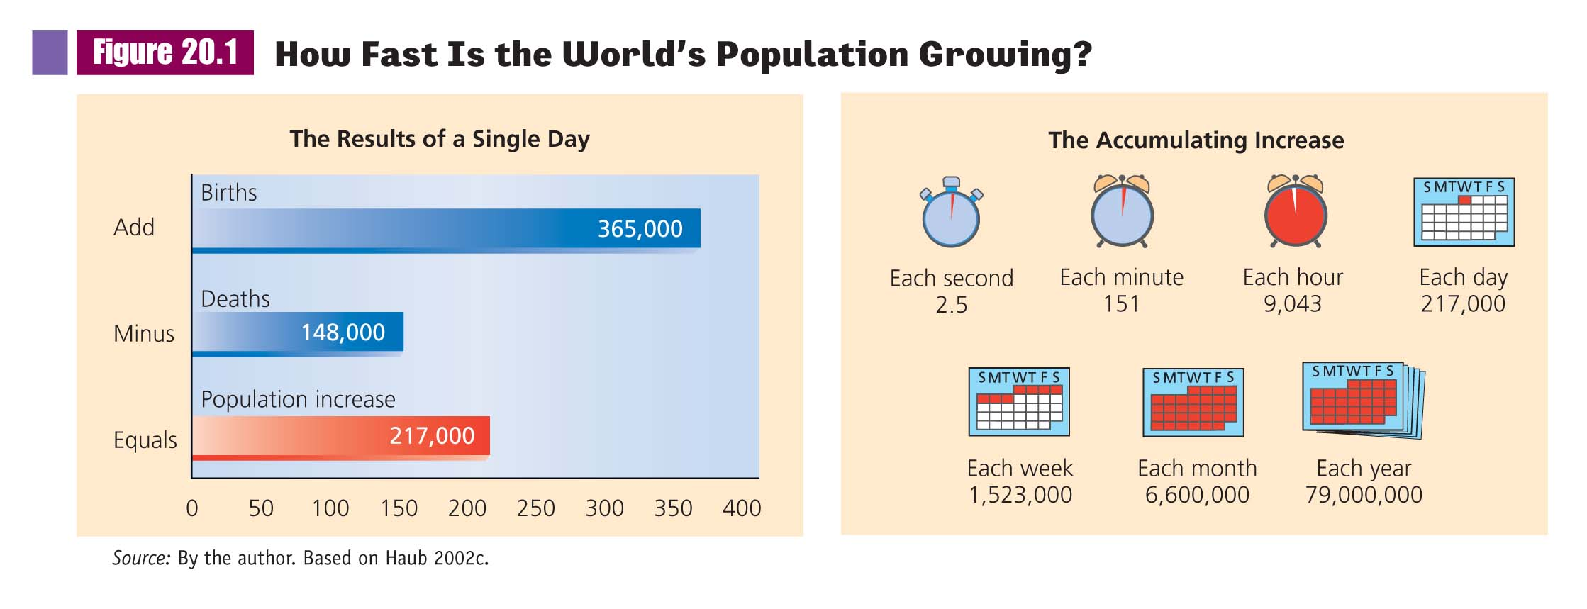

Slide 3
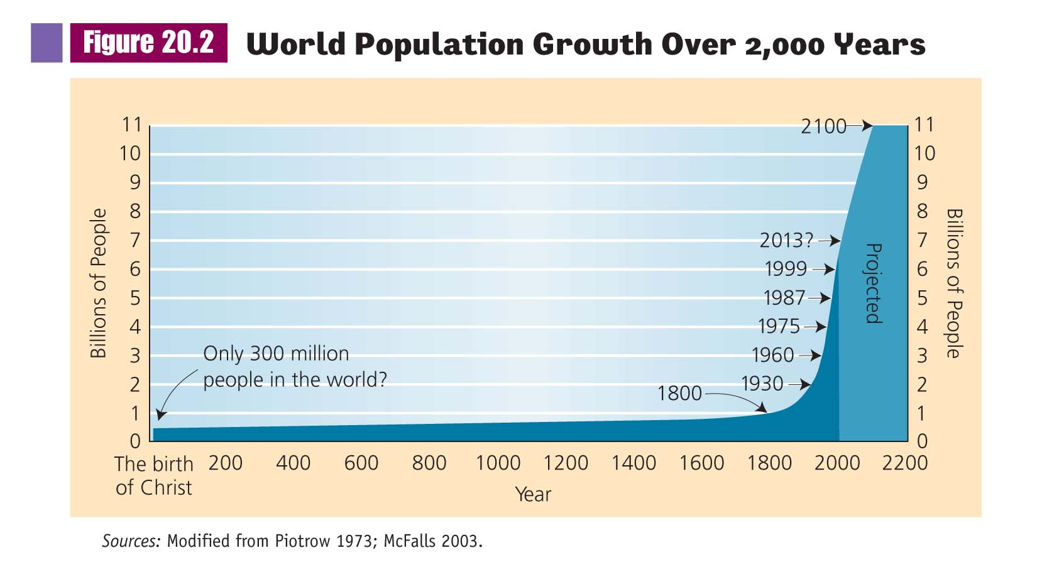

Slide 4
Population in Global Perspective
No Space for Enjoying Life?
The New Malthusians
The Anti-Malthusians

Slide 5
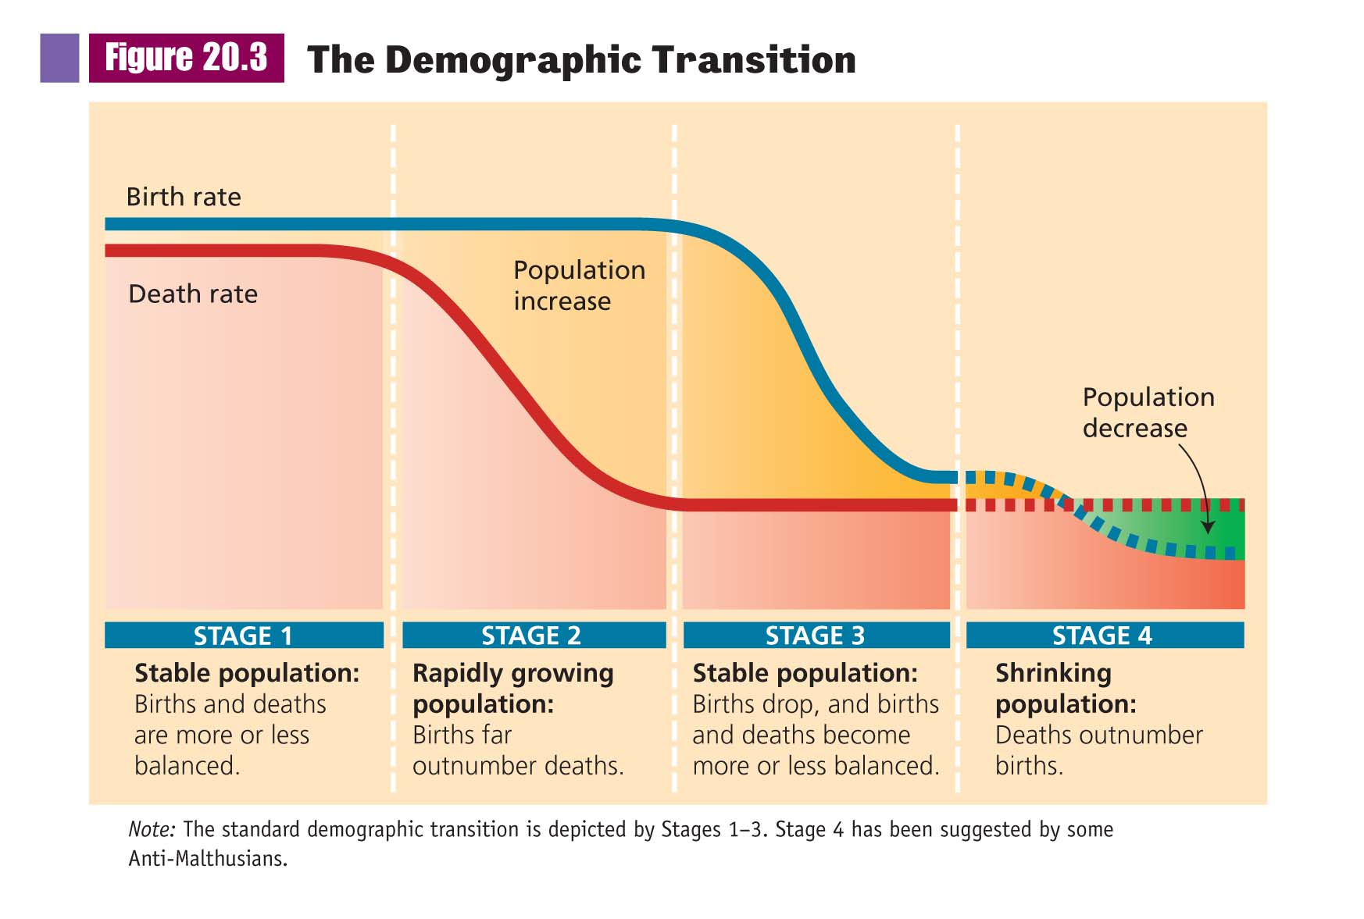

Slide 6
Population in Global Perspective
No Space for Enjoying Life?
The New Malthusians
The Anti-Malthusians
Who is Correct?

Slide 7
Population in Global Perspective
Why Are People Starving?
Now More Food Per Person Produced

Slide 8
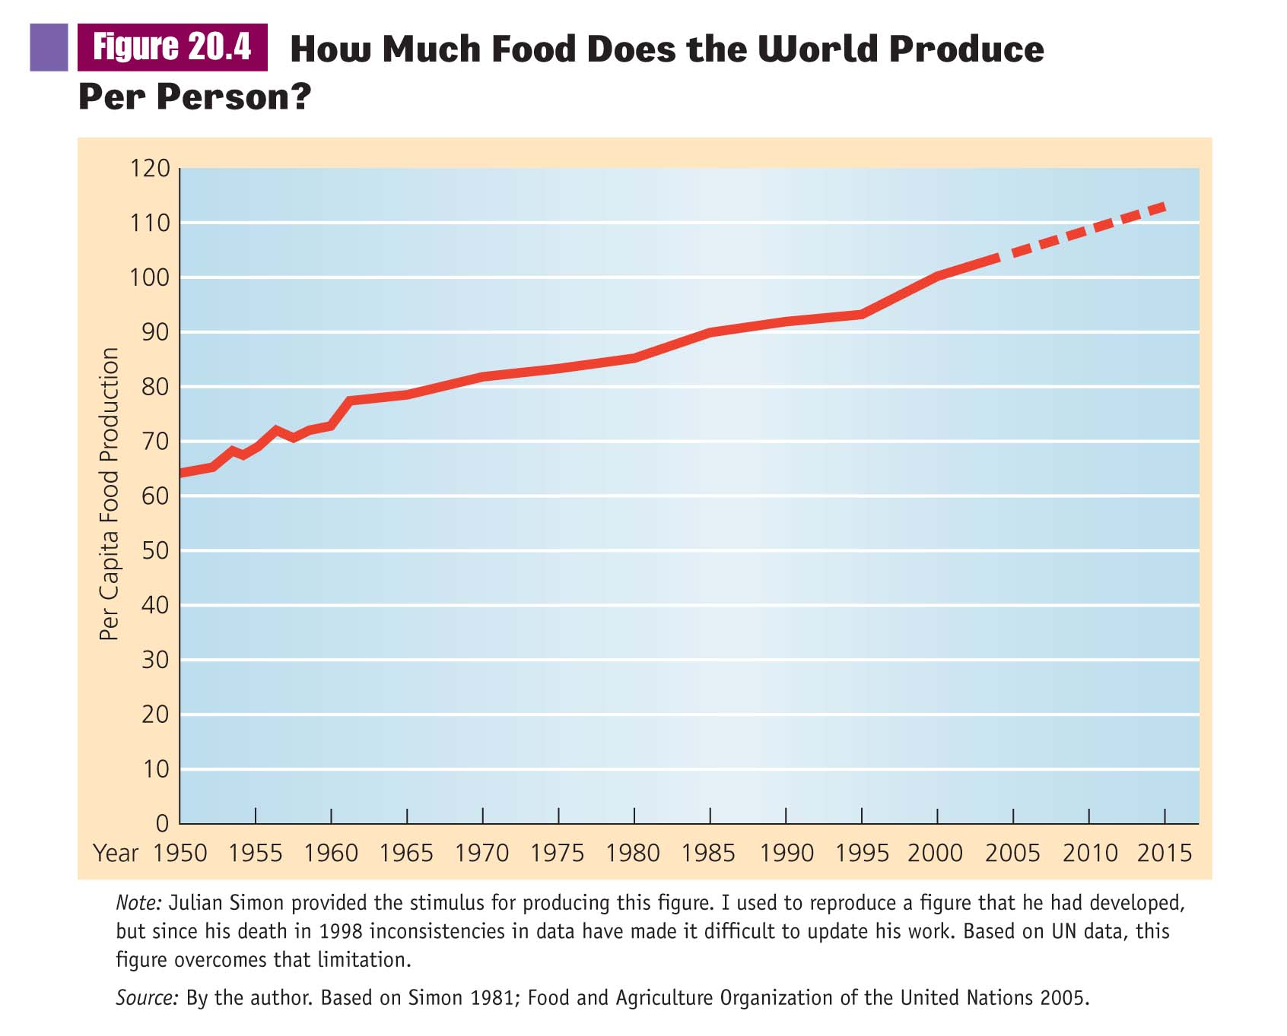

Slide 9
Population in Global Perspective
Why Are People Starving?
Now More Food Per Person Produced
Starvation Occurs in Particular Places
Droughts
Wars

Slide 10
Population Growth
Why Do Least Industrialized Nations Have So Many Children?

Slide 11
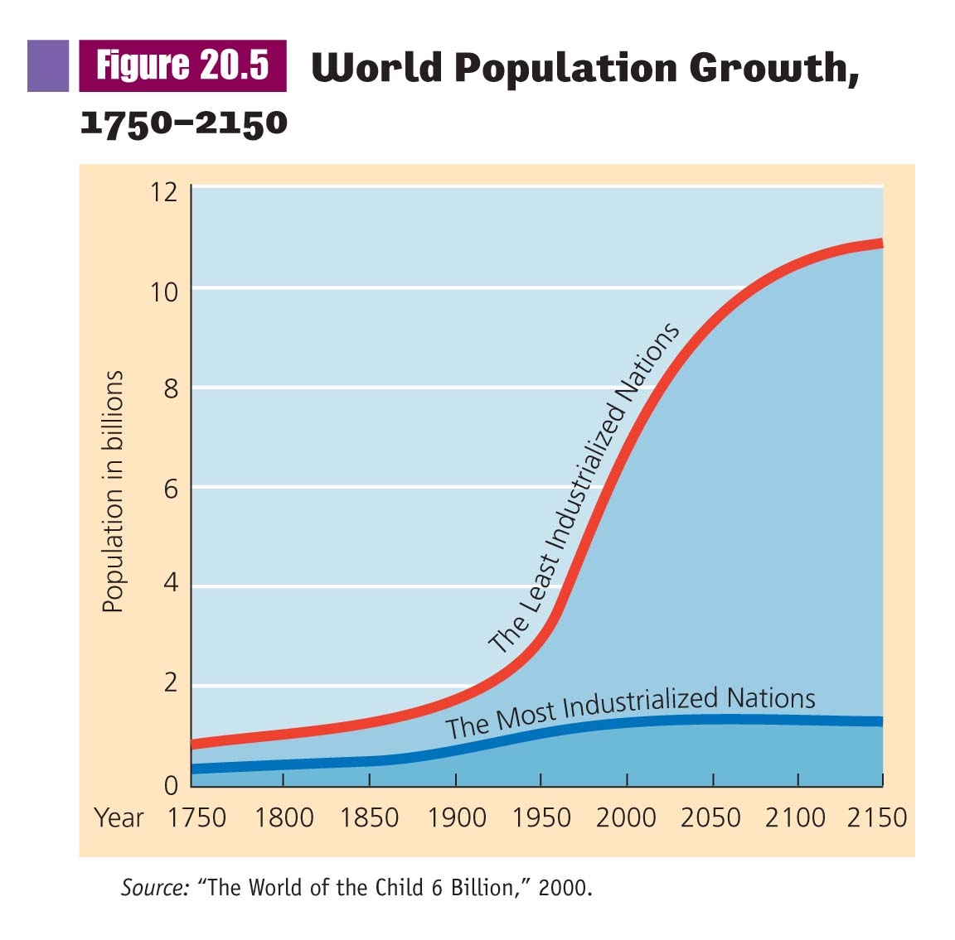

Slide 12
Population Growth
Status of Parenthood
Community Support
Reliance on Children in Old Age
Why Do Least Industrialized Nations Have So Many Children?

Slide 13
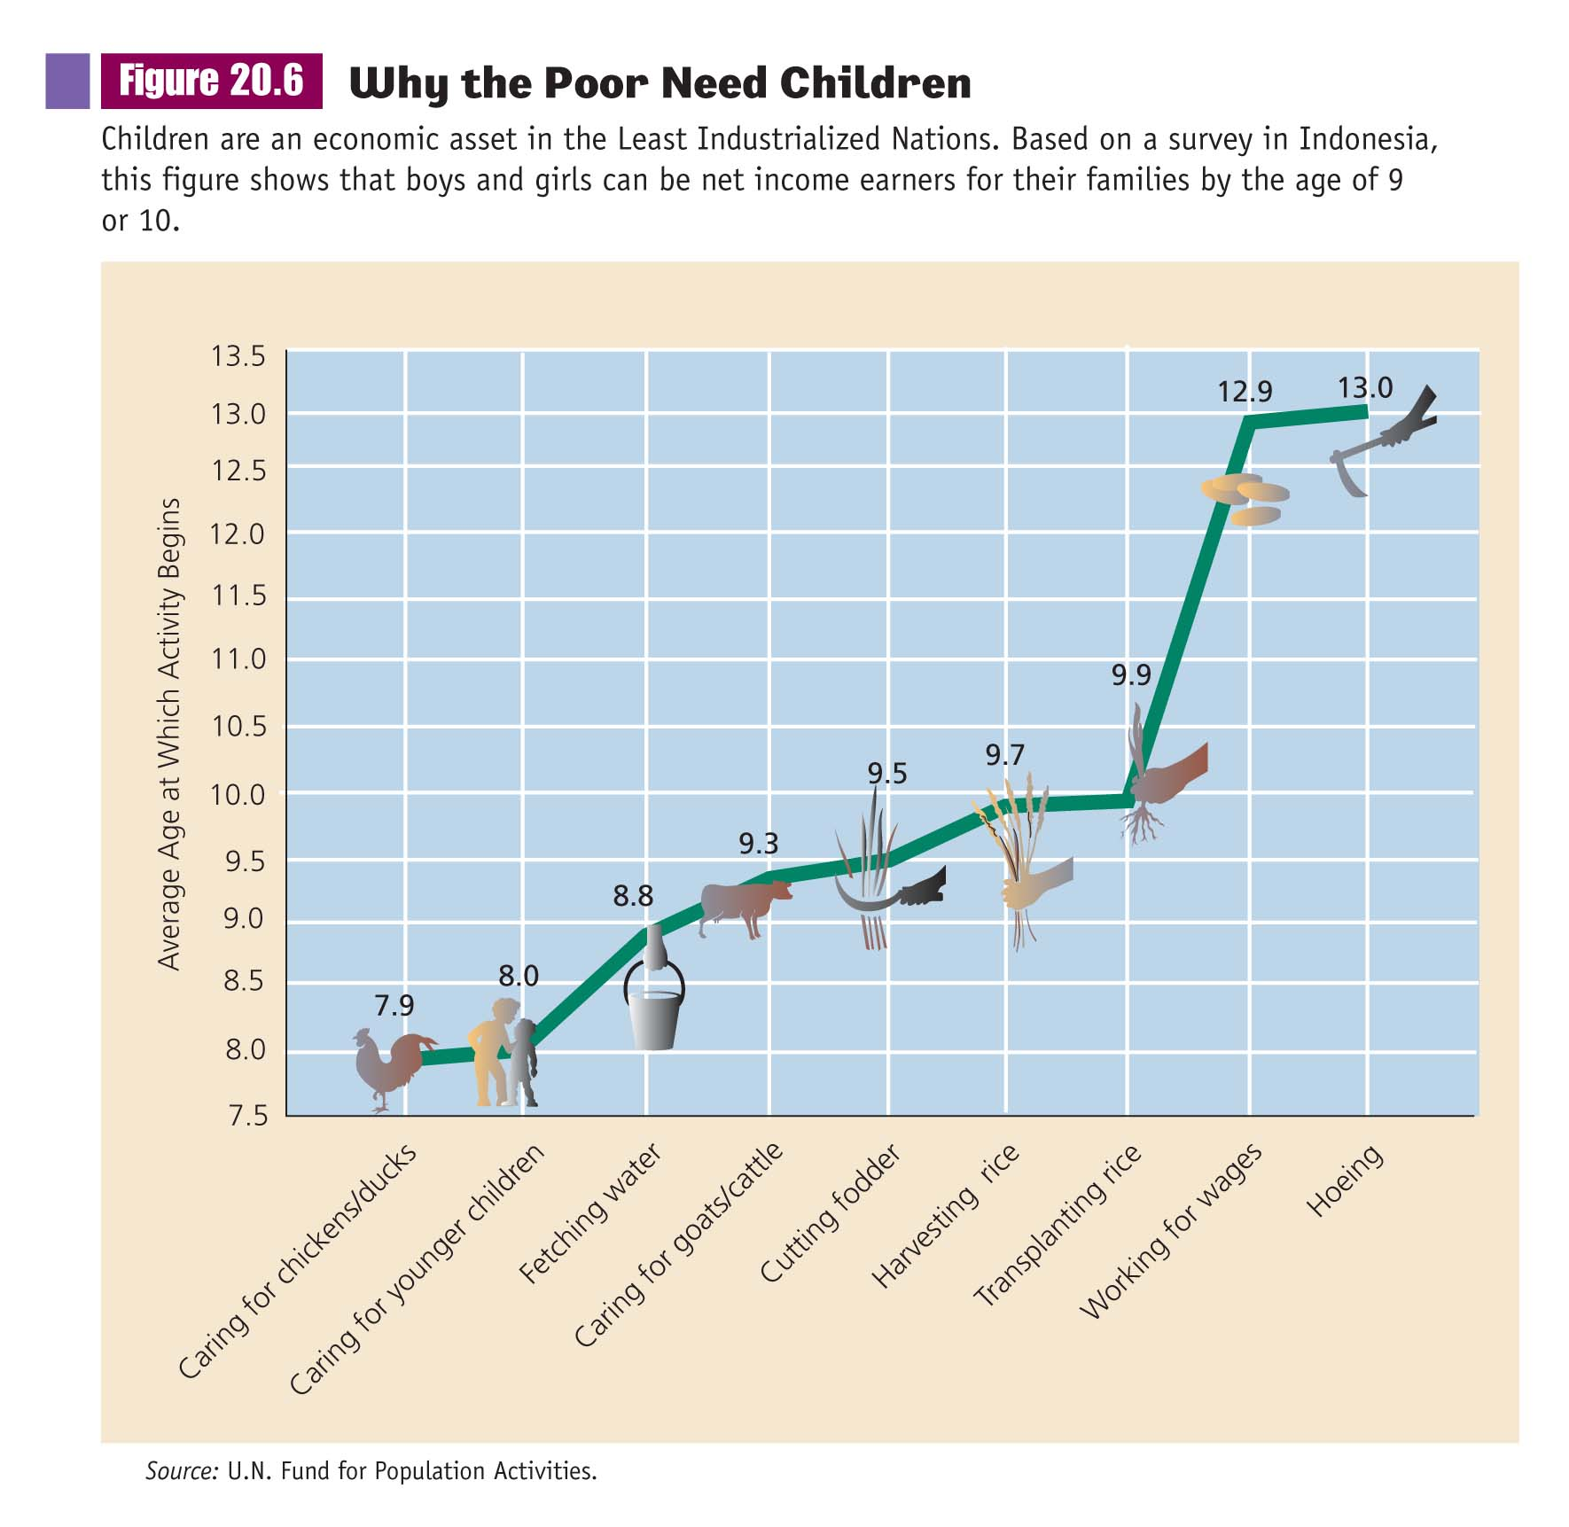

Slide 14
Population Growth
Implications of Different Growth Rates
Population Pyramids

Slide 15
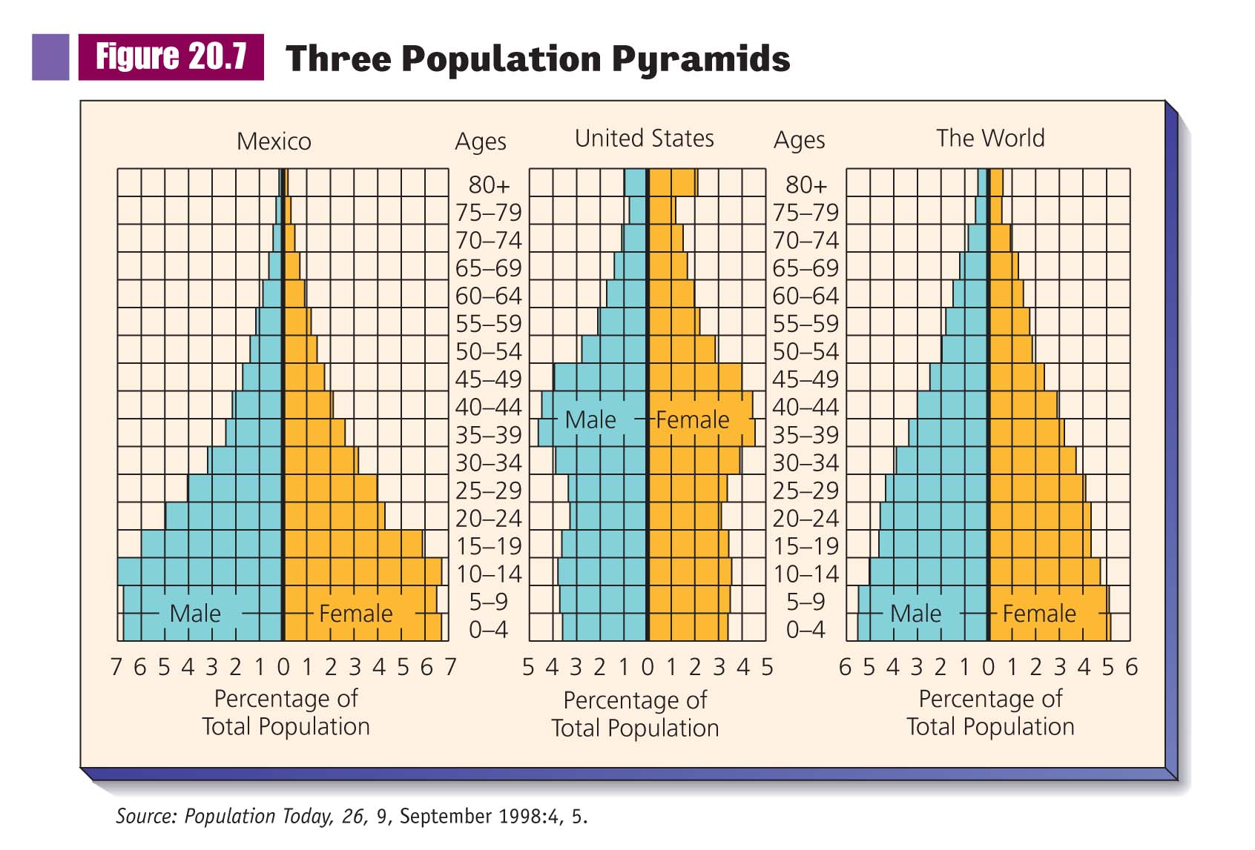

Slide 16
Population Growth
Implications of Different Growth Rates
Population Pyramids
Population Momentum
Standards of Living

Slide 17
Population Growth
Demographic Variables
Fertility
Mortality
Migration

Slide 18
Population Growth
Problems in Forecasting Population Growth
Basic Demographic Equation
Growth Rate=Births - Deaths + Net Migration

Slide 19
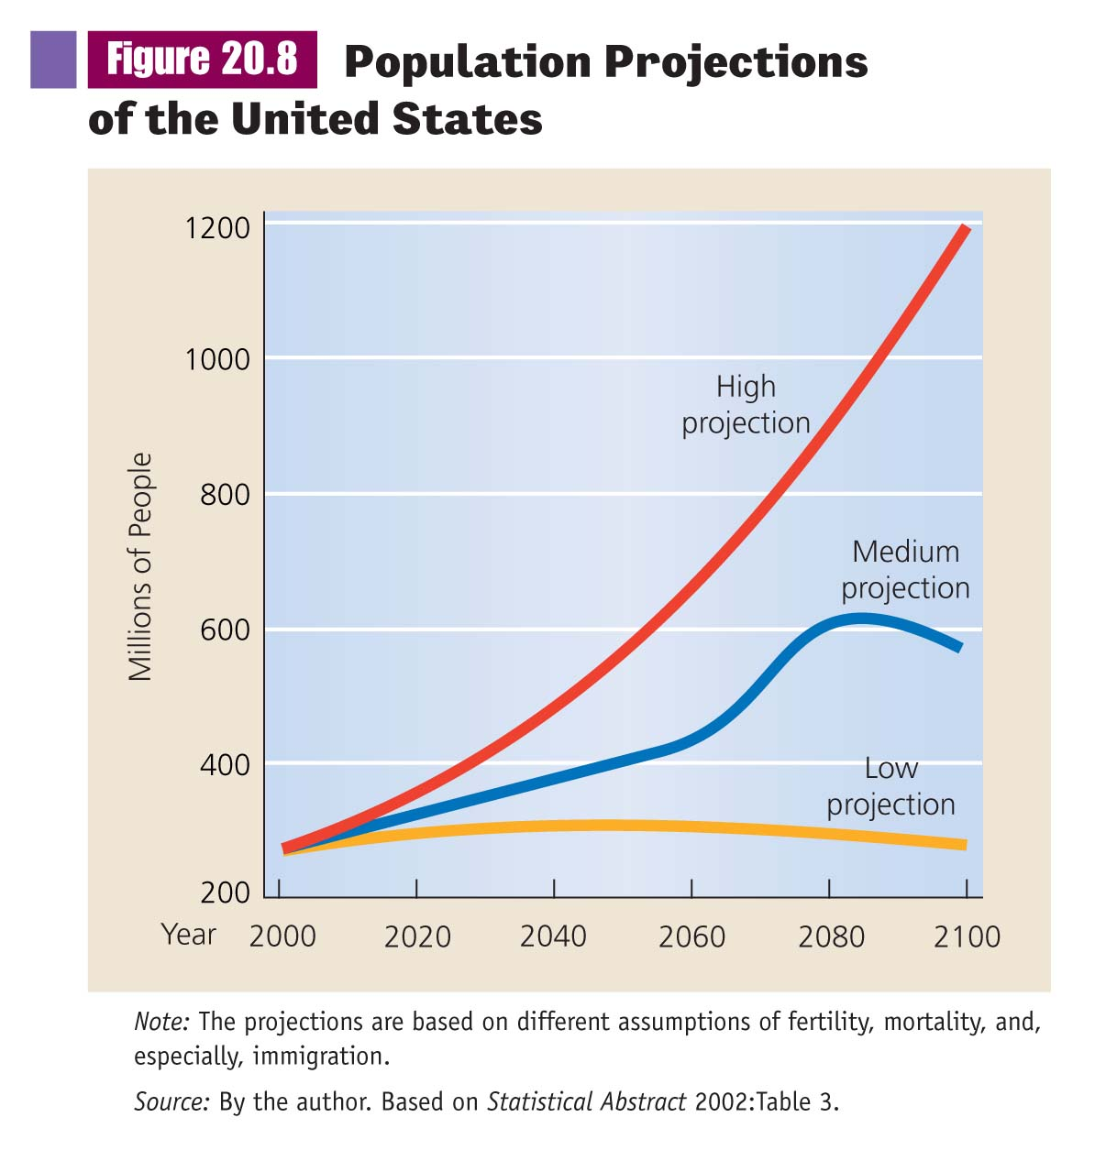

Slide 20
Population Growth
Problems in Forecasting Population Growth
Social Factors Complicate
Example of China
Industrialization

Slide 21
Urbanization
The Development of Cities
The Process of Urbanization
Metropolises
Megalopolises

Slide 22
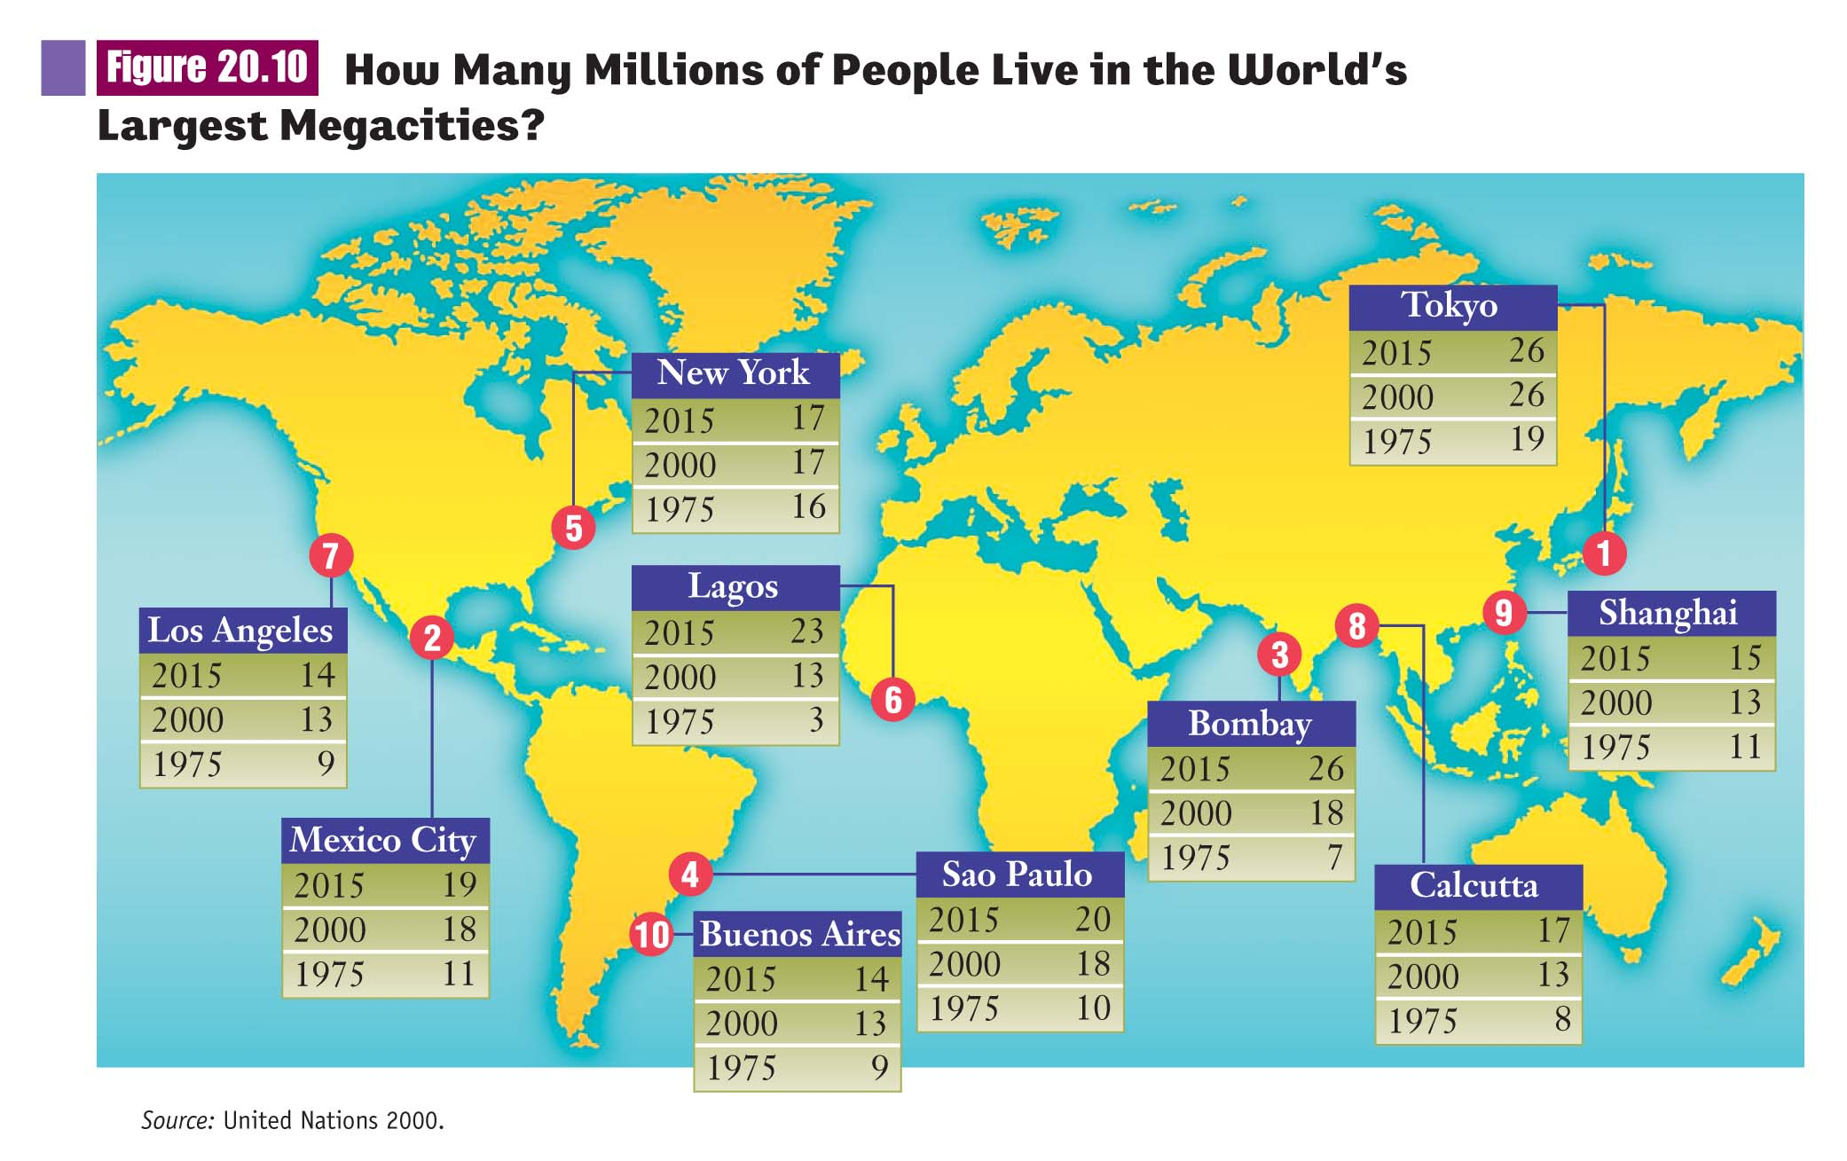

Slide 23
Urbanization
U.S. Urban Patterns
From Country to City
From City to City
Between Cities
Within the City
From City to Suburb
Smaller Centers
The Rural Rebound

Slide 24
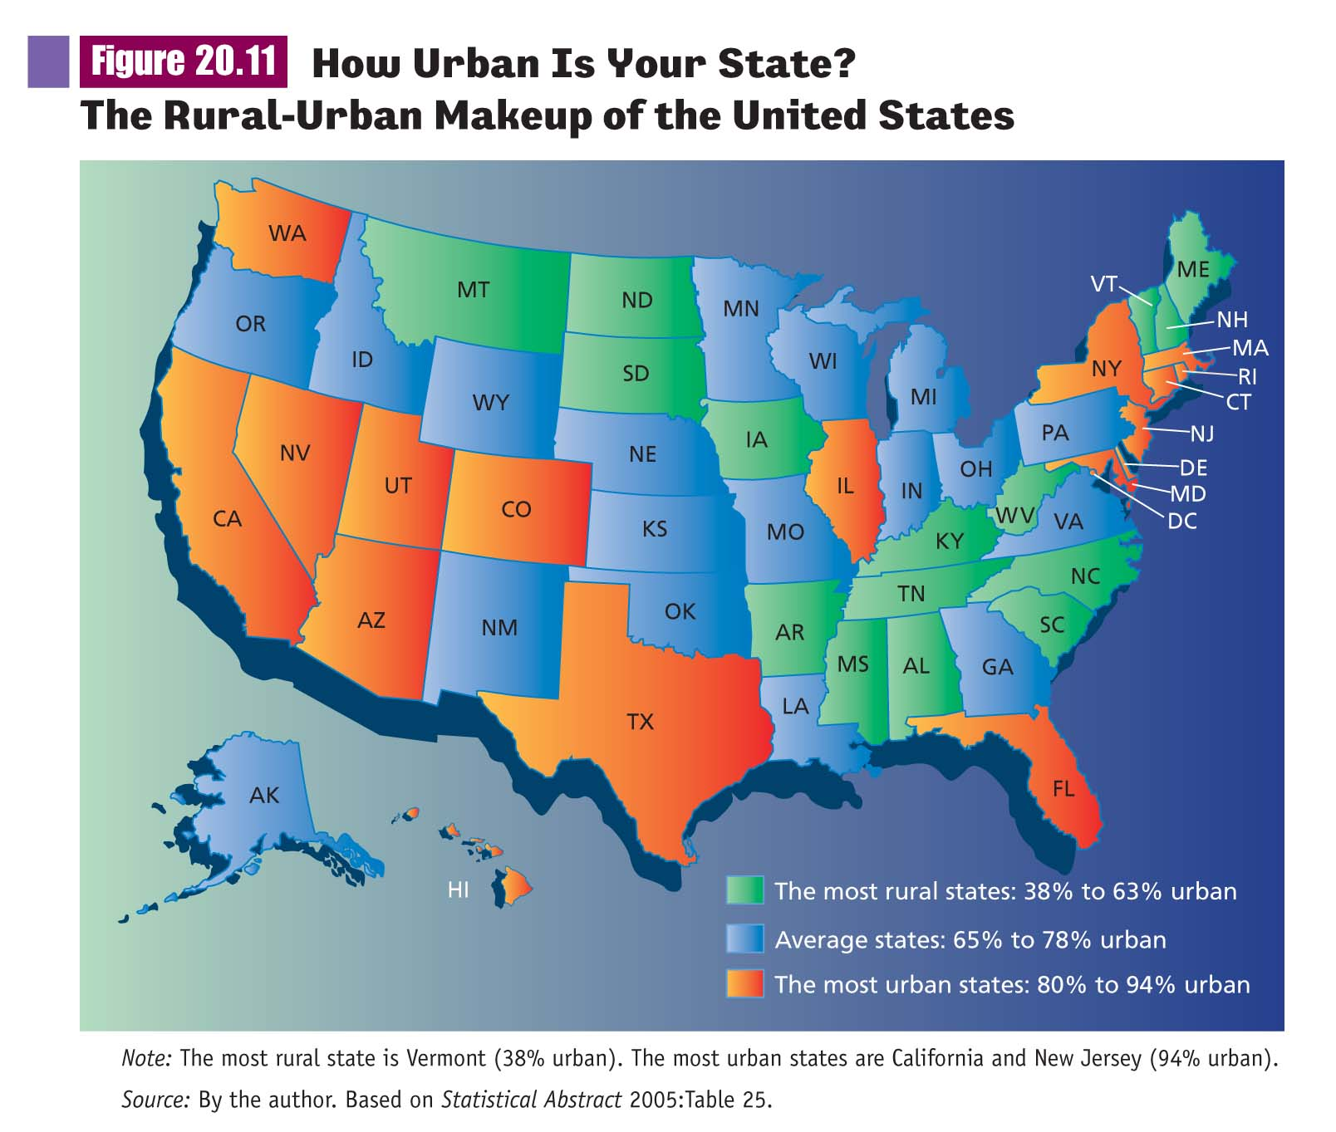

Slide 25
Models of Urban Growth
The Concentric Zone Model
The Sector Model

Slide 26
Models of Urban Growth
The Multiple-Nuclei Model
The Peripheral Model

Slide 27
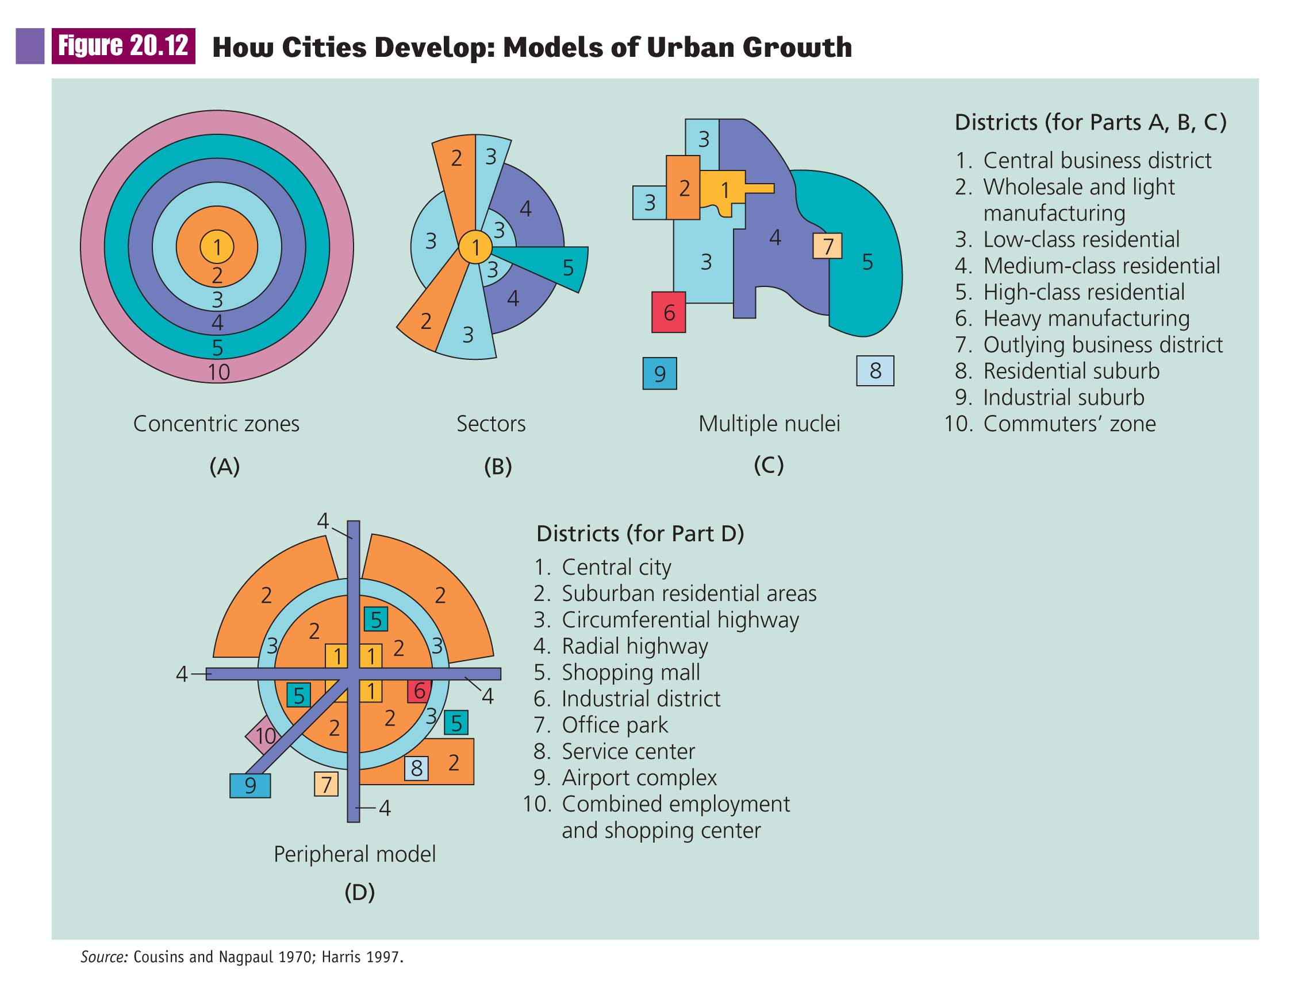

Slide 28
Models of Urban Growth
Critique of the Models
They are Time-Bound
They Do Not Account for Urban Planning
Fall Short with Cities in Least Industrialized Nations

Slide 29
City Life
Alienation and Community
Human Need for Community
Kitty Genovese
Cities Undermine Kinship and Neighborhood Relationships
Series of Smaller Worlds

Slide 30
City Life
Who Lives in the City?
The Cosmopolites
The Singles
The Ethnic Villagers
The Deprived
The Trapped

Slide 31
City Life
Urban Sentiment: Finding a Familiar World
City Divided into Little Worlds
People Create Intimacy by Personalizing Shopping
Spectator Sports Provide Venue

Slide 32
City Life
Norm of Noninvolvement
Diffusion of Responsibility

Slide 33
Urban Problems and Social Policy
Suburbanization
Movement of People from Cities to Suburbs
City Centers Lose in Transition
City vs. Suburb

Slide 34
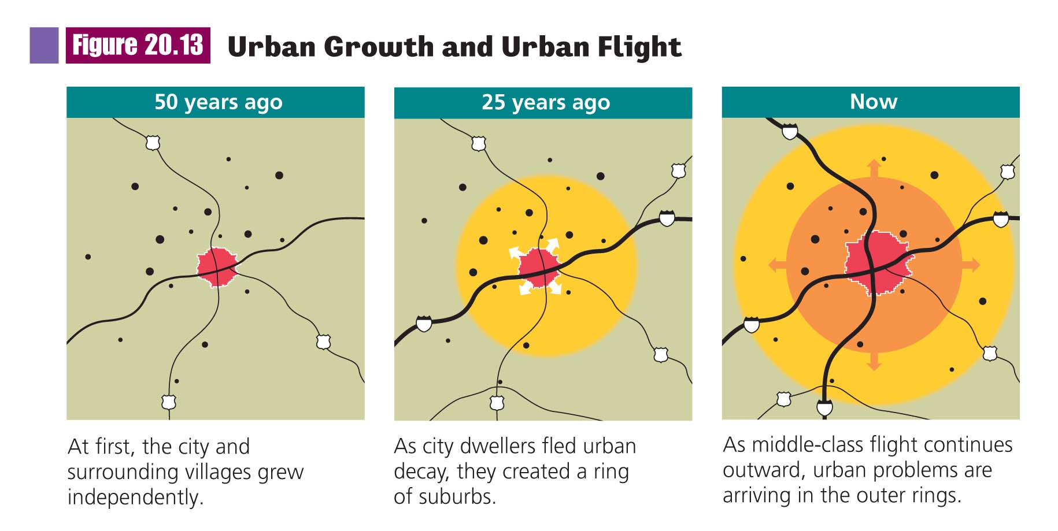

Slide 35
Urban Problems and Social Policy
Suburban Flight
Disinvestment and Deindustrialization
Potential Urban Revitalization

Slide 36
How Social Change Transforms Social Life
Four Social Revolutions
From Gemeinschaft to Gesellschaft
Capitalism, Modernization, and Industrialization

Slide 37
How Social Change Transforms Social Life
Social Movements
Conflict, Power, and Global Politics

Slide 38
Theories and Processes of Social Change
Cultural Evolution
Natural Cycles
Conflict Over Power

Slide 39
How Social Change Transforms Social Life
Marx’s Model of Historical Change
Thesis (Current Arrangement of Power)
Antithesis (Contradiction)
Synthesis (New Arrangement of Power)
Classless State

Slide 40
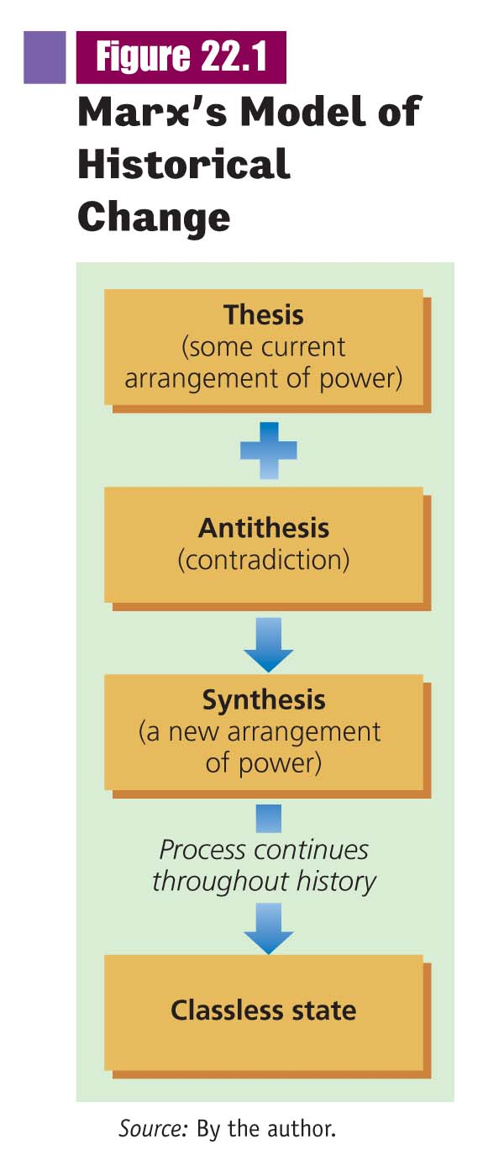

Slide 41
Theories and Processes of Social Change
Ogburn’s Theory
Invention
Discovery
Diffusion
Cultural Lag

Slide 42
Theories and Processes of Social Change
Evaluation of Ogburn’s Theory
Too Unidirectional
The Way People Adapt to Technology Only Part of the Story
However, He Never Said Technology was the Only Force for Social Change

Slide 43
How Technology Changes Society
Technology is Tools and Skills
Postmodern Societies Possess Technology that Greatly Extend Human Ability

Slide 44
The Extent of the Transformation
Changes in Social Organization
Changes in Ideology
Changes in Ostentatious Consumption
Changes in Social Relationships

Slide 45
The Impact of the Automobile
Displacement of Existing Technology
Effects on Cities
Effects on Farm Life and Villages
Changes in Architecture
Changed Courtship and Sexual Norms
Effects on Women’s Roles

Slide 46
The Cutting Edge of Change
Computers in Education
Computers in the Workplace
Computers in Business and Finance
Changes in the War

Slide 47
Cyberspace and Social Inequality
Access to Libraries of Information
World Linked by Almost Instantaneous Communication
National and Global Stratification Represents a Digital Divide

Slide 48
The Growth Machine vs. The Earth
Environmental Problems in the Most Industrialized Nations
Industrial Growth at the Cost of Natural Environment
Major Polluters in Most Industrialized Nations

Slide 49
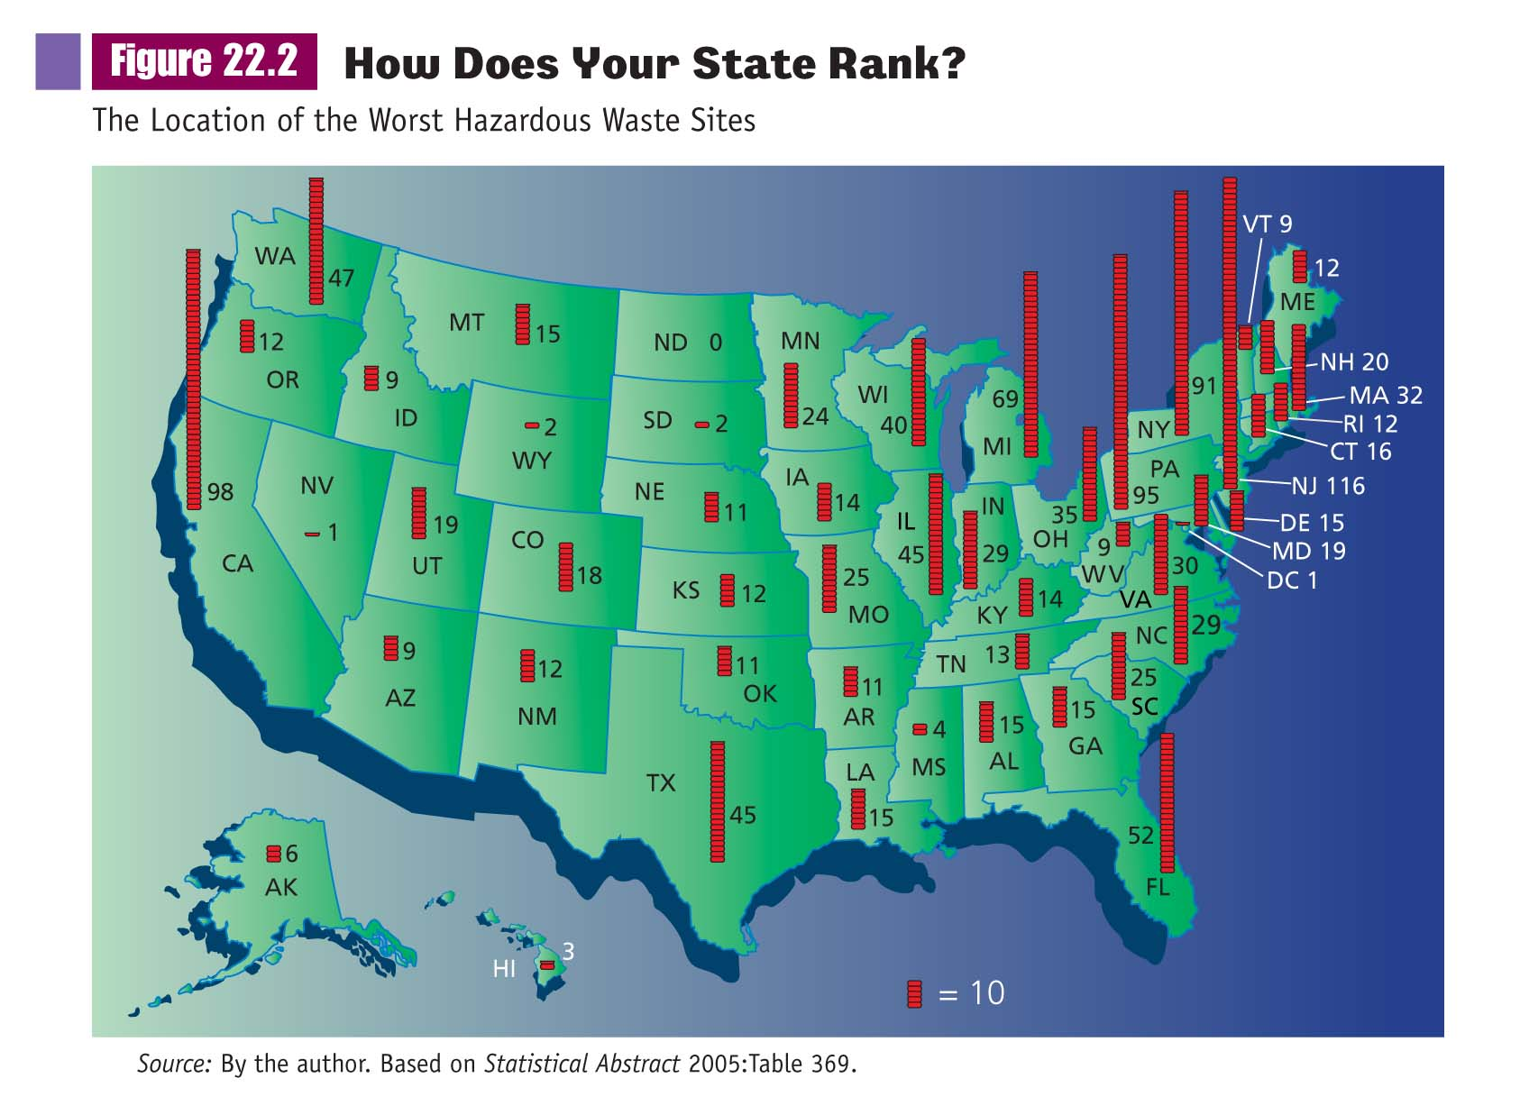

Slide 50
The Growth Machine vs. The Earth
Fossil Fuels and the Environment

Slide 51
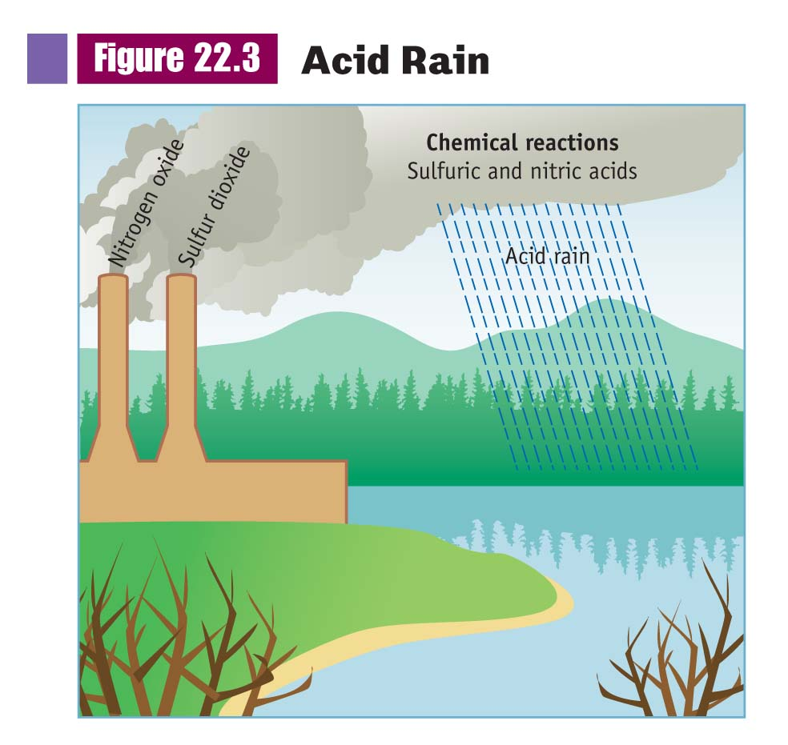

Slide 52
The Growth Machine vs. The Earth
Environmental Injustice
Fossil Fuels and the Environment
The Energy Shortage and Multinational Corporations

Slide 53
Environmental Problems in Industrializing Nations
Ozone Depletion
Greenhouse Effect
Global Warming

Slide 54
Environmental Problems in Least Industrialized Nations
Exported Pollution from Industrialized Nations
Destruction of Habitat
Disappearance of Rain Forests

Slide 55
The Environmental Movement
Green Political Parties
Activists Seek Solutions in…
Politics
Education
Legislation

Slide 56
Environmental Sociology
Main Assumptions:
Physical Environment a Significant Variable
Human Beings Depend on Natural Environment
Human Actions Have Unintended Consequences
The World is Finite; Limits to Economic Growth

Slide 57
Environmental Sociology
Main Assumptions:
Economic Expansion Requires Extraction of Resources from Environment
Increased Extractions Lead to Ecological Problems
Ecological Problems Restrict Economic Expansion
Governments Create Environmental Problems

Slide 58
Environmental Sociology
Technology and the Environment: The Goal of Harmony
Abuse of Environment Not Inevitable
Must Discover Ways to Reduce or Eliminate Harm to the Environment

